Slide 1

DSC202: Game Recommendation
Team Member: Sihan Wang, Jiacheng Qiu, Xueqi Wang
HDSI | December 12, 2023

Slide 2
Contents
1
Introduction
2
New Game Recommendation
3
Game Clustering
4
Topic Modeling

Slide 3

Introduction
Games.csv:
Application id, title, date release, price, discount, system support, positive ratio, rating, number of user reviews, etc.
Users.csv:
User id, number of games, number of reviews
Recommendations.csv:
Application id, helpful/funny, date, is_recommended, hours, review id, user id.
Games_metadata.json:
Application id, description of the game

Slide 4
Introduction
New Game Recommendation
Generate a new random game and estimate the positive ratio of this new game.
Game Clustering
Cluster games after PCA.
Topic Modeling
Extract game tags with description information in the json file using topic model.

Slide 5
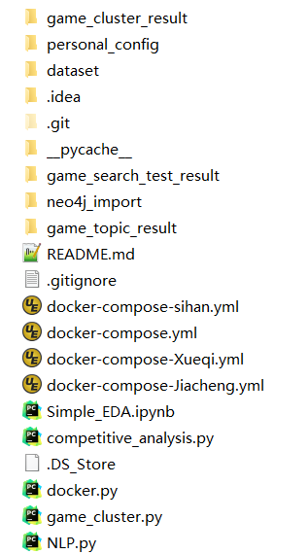
Introduction
Modular Design
Dataset Folder
Personal Config Folder
Result Folder
Data Import Module
Game Clustering Module
Topic Modeling Module
New Game Recommendation Module

Slide 6
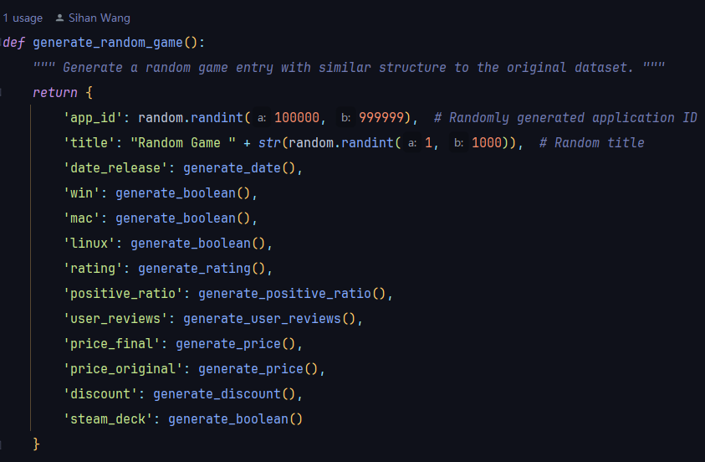
New Game Recommendation
Generate a random game
Same schema

Slide 7
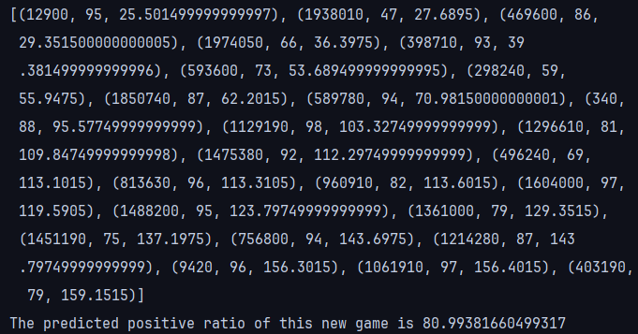
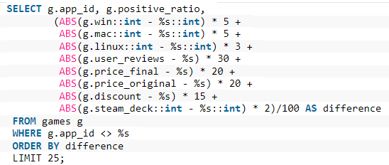
New Game Recommendation
Insert the new game into postgres
Create similarity query
Calculate the new game’s positive ratio

Slide 8
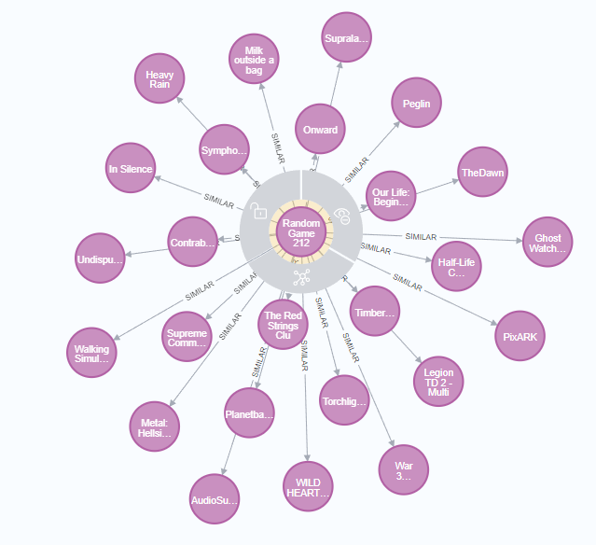
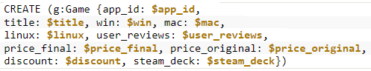
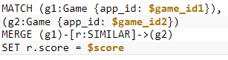
New Game Recommendation
Create Game Node in Neo4j
Create relations between the new game
and existing similar games

Slide 9
Game Clustering
Database
MongoDB: Leveraged MongoDB for textual and tag-based searches.
PostgreSQL: Utilized PostgreSQL for structured data queries, such as titles and user reviews.
Combined Result: Cross-referenced results by app IDs to merge MongoDB and PostgreSQL data. Ensured completeness by including all relevant features from both databases.

Slide 10
Game Clustering
Cluster preparation
Fetch Original Data: Utilized comprehensive game data from PostgreSQL, including ratings, reviews, prices, discounts, and platform compatibility.
Data Analysis through PCA: Leveraged Principal Component Analysis (PCA) to effectively reduce dimensionality of the comprehensive game dataset from PostgreSQL.
Extracting Key Components: Focused on the first five principal components, which collectively account for over 80% of the Explained Variance Ratio.

Slide 11
Game Clustering
Cluster Game
Clustering with PCA Components: Utilized the five principal components derived from PCA for clustering.
Cluster | Key Feature | Name
1 | Moderate ratings/reviews, Windows-focused, average price. | Balanced Windows Games
2 | High ratings, large reviews, multi-platform, slightly high price. | Popular Multi-Platform Titles
3 | Very high ratings, substantial reviews, mostly Windows, higher price. | Mainstream Premium Games
4 | Exceptional ratings, fewer reviews, non-Windows, lower price. | Niche Games
5 | Moderate ratings, highest reviews, free. | Free-to-Play Games
6 | High ratings, significant reviews, high discounts. | Discounted Favourites Games

Slide 12
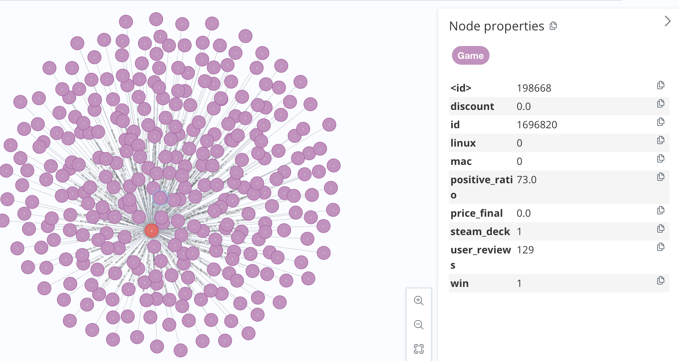
Game Clustering
Visualizing Game Clusters with Neo4j
Neo4j Data Integration: Transformed PostgreSQL data into Neo4j graph format via CSV.
Graphical Synopsis: Displayed games as nodes; interlinked by similarities and user ties. Focused on a specific cluster, revealing a segment of the gaming landscape.
Blue Notch Templae

Slide 13
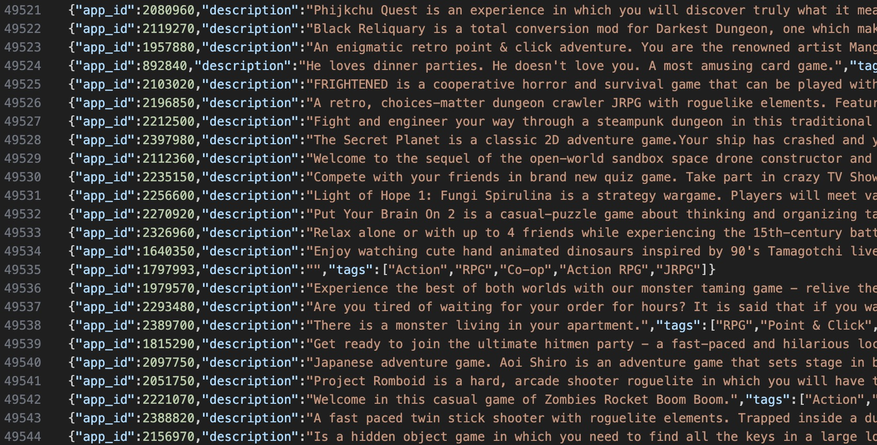
Topic Modeling
Games json dataset
MongoDB: Schema Flexibility, Large Document Size, Querying and Indexing, and Document-Oriented Storage.

Slide 14
Topic Modeling
LDA (Latent Dirichlet Allocation) Model
Strengths
Topic Discovery: discovering hidden topics in a collection of documents and identifying the underlying themes or topics that are prevalent in the game descriptions.
Unsupervised Learning: LDA is an unsupervised learning algorithm. This makes it suitable for text data.
Generative Model: LDA provides a generative probabilistic model for how documents are generated.
Weaknesses
Sensitivity to Number of Topics: The performance of LDA is sensitive to the choice of the number of topics.
Homogeneity of Topics: LDA assumes that each document is generated from a mixture of topics, but in reality, documents can be more homogeneous.

Slide 15
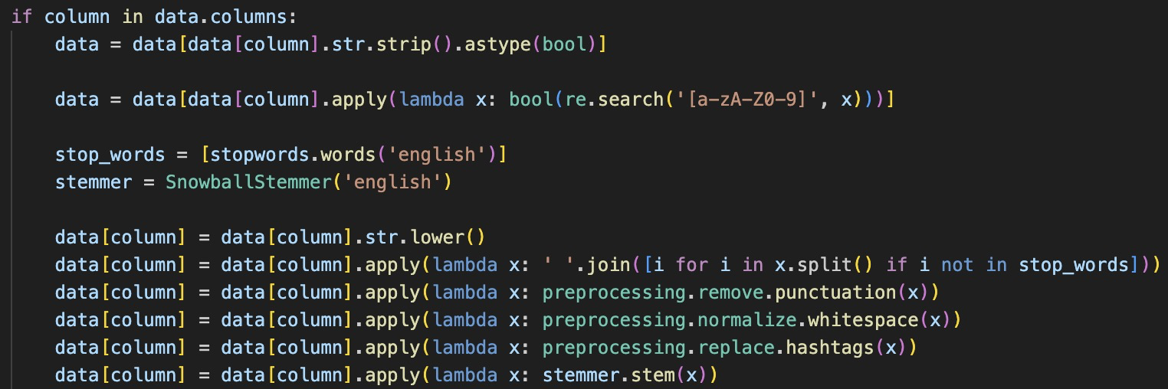
Topic Modeling
LDA (Latent Dirichlet Allocation) Model
Data processing
These steps help to ensure that the text data is in a suitable and consistent format for extracting meaningful topics. The use of stop words removal and stemming can help focus on the essential content of the text.

Slide 16
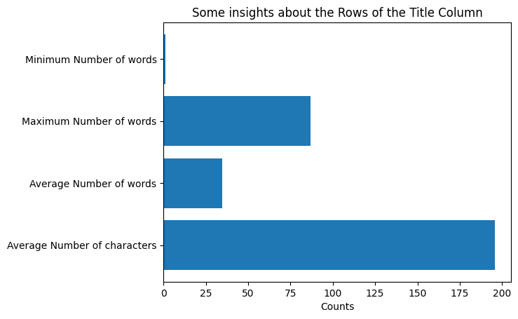
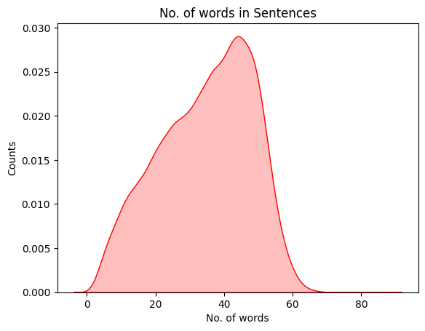
Topic Modeling
Data processing
Information of Processed Data

Slide 17
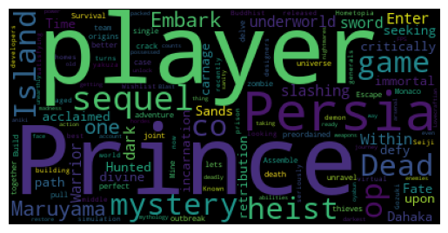
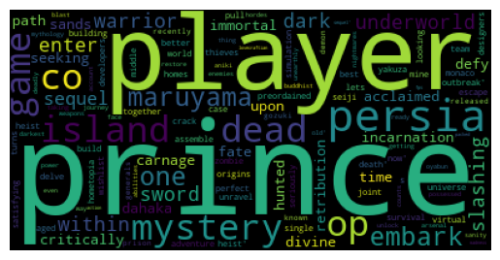
Topic Modeling
Wordcloud of the text data
Wordcloud generated from the original description
Wordcloud generated from processes text data

Slide 18
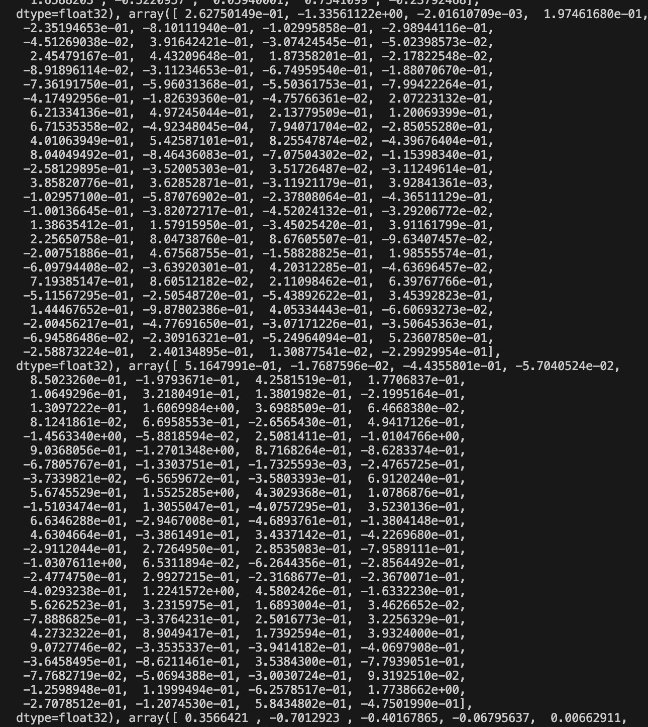
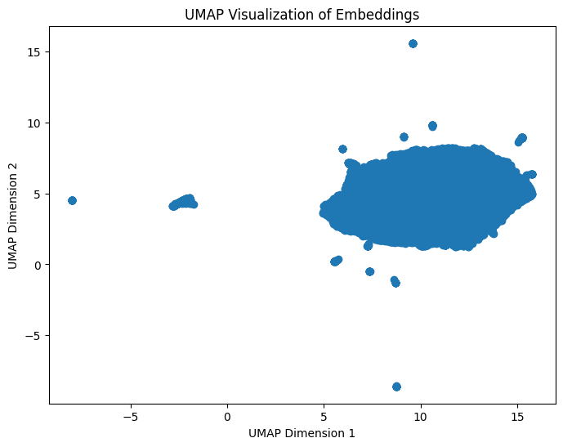
Topic Modeling
Data Embedding

Slide 19
Topic Modeling
Topic | Topic Keywords | Count
1 | ['ogr', 'cliffhouse', 'suitcases', 'praetorians', 'washes', 'idyllic', 'cartown', 'vulpes', 'disappointment', 'juego', 'zugs', 'avenue', 'ghosthunter', 'hug', 'bulbs', 'cousins', 'bitmaster'] | 4024
2 | ['vulpes', 'cliffhouse', 'juego', 'negotiating', 'cartown', '来试试', 'nom', 'washes', 'disappointment', 'carne', 'hug', 'trivial', 'namesake', 'outnumbered', 'hunting', 'ghosthunter', 'bitmaster'] | 5460
3 | ['dunos', 'calculating', 'accel', 'tombstar', 'drive', 'establishes', 'miaoli', 'miles', 'gaypolice', 'capers', 'terrazael', 'av8b', 'blademaster', 'beavercity', 'ferrymaster', 'offense', 'karma'] | 1309
4 | ['nom', 'avenue', 'cartown', 'vulpes', 'negotiating', 'praetorians', 'ghosthunter', 'fortiana', 'suitcases', 'dragonkind', 'carne', 'hunting', 'washes', 'namesake', 'zugs', 'eyesight', 'disappointment'] | 4915
5 | ['avenue', 'fortiana', 'cliffhouse', 'bot', 'bulbs', 'privy', 'vulpes', 'trivial', 'washes', 'filthiest', 'nom', 'praetorians', 'outnumbered', 'liblade', 'negotiating', 'popularity', 'fishery'] | 4483
6 | ['ogr', 'suitcases', 'trivial', 'vulpes', 'cliffhouse', 'outnumbered', 'juego', 'avenue', 'fortiana', 'filthiest', 'negotiating', 'hunting', 'carne', 'washes', 'disappointment', 'bot', 'dreaming'] | 4419
7 | ['avenue', 'praetorians', 'suitcases', 'nom', 'negotiating', 'vulpes', 'cliffhouse', 'cartown', 'bulbs’, 'washes', 'fortiana', 'zugs', 'ghosthunter', 'dragonkind', 'capsul', 'disappointment', 'liblade'] | 2294
8 | ['avenue', 'vulpes', 'nom', 'fortiana', 'praetorians', 'dreaming', 'bot', 'suitcases', 'coffin', 'bulbs', 'trivial', 'dragonkind', 'cartown', 'negotiating', 'outnumbered', 'hunting', 'serious'] | 7977
9 | ['suitcases', 'cliffhouse', 'vulpes', 'juego', 'negotiating', 'washes', '来试试', 'cartown', 'disappointment', 'praetorians', 'idyllic', 'avenue', 'ghosthunter', 'bitmaster', 'cousins', 'zugs', 'carne'] | 3174
10 | ['suitcases', 'avenue', 'vulpes', 'washes', 'negotiating', 'cartown', 'juego', 'bulbs', 'filthiest', 'idyllic', 'trivial', 'outnumbered', 'cousins', 'fishery', 'nom', 'praetorians', 'privy'] | 2063

Slide 20
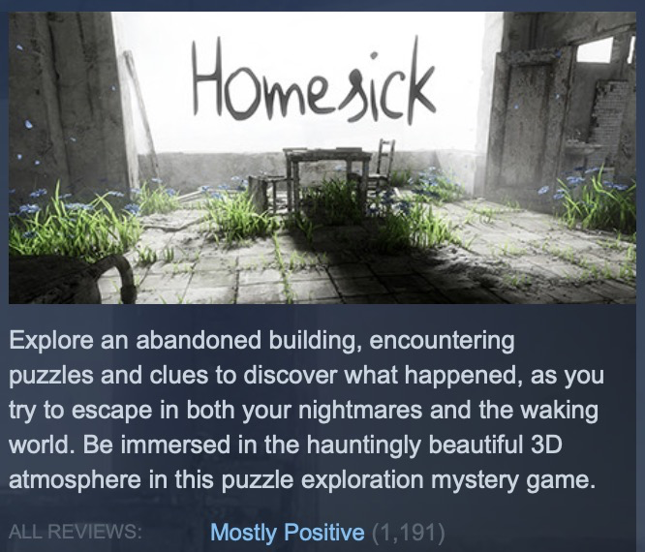
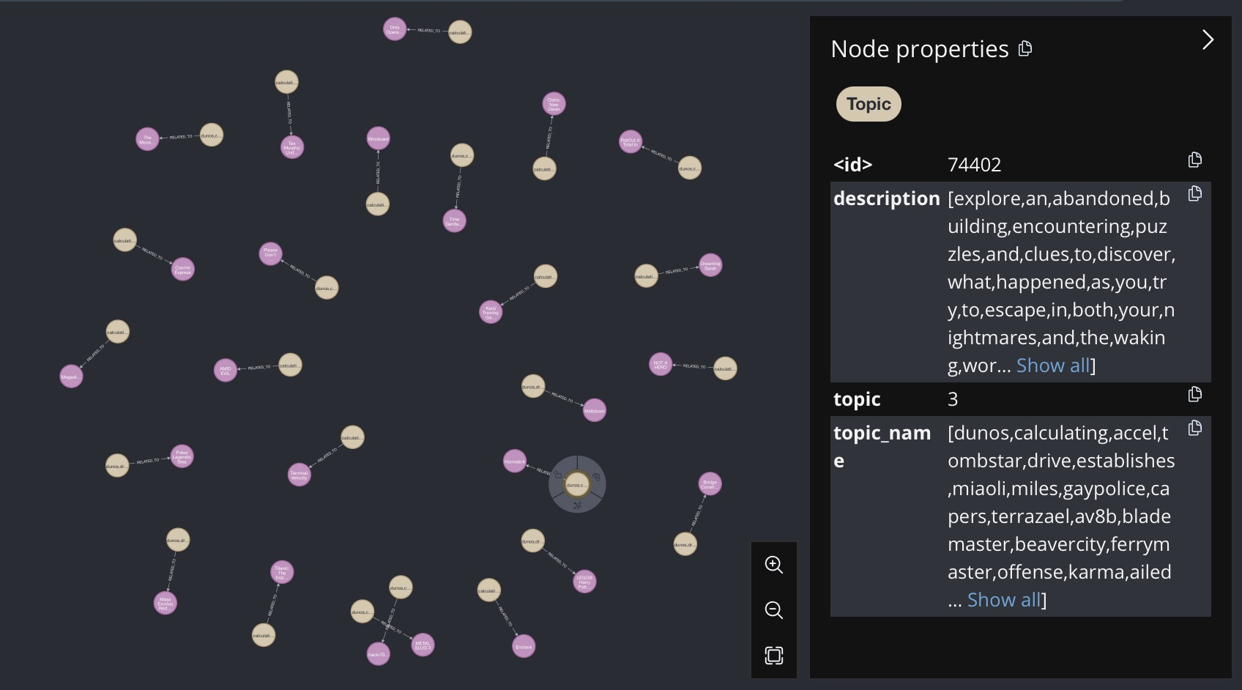
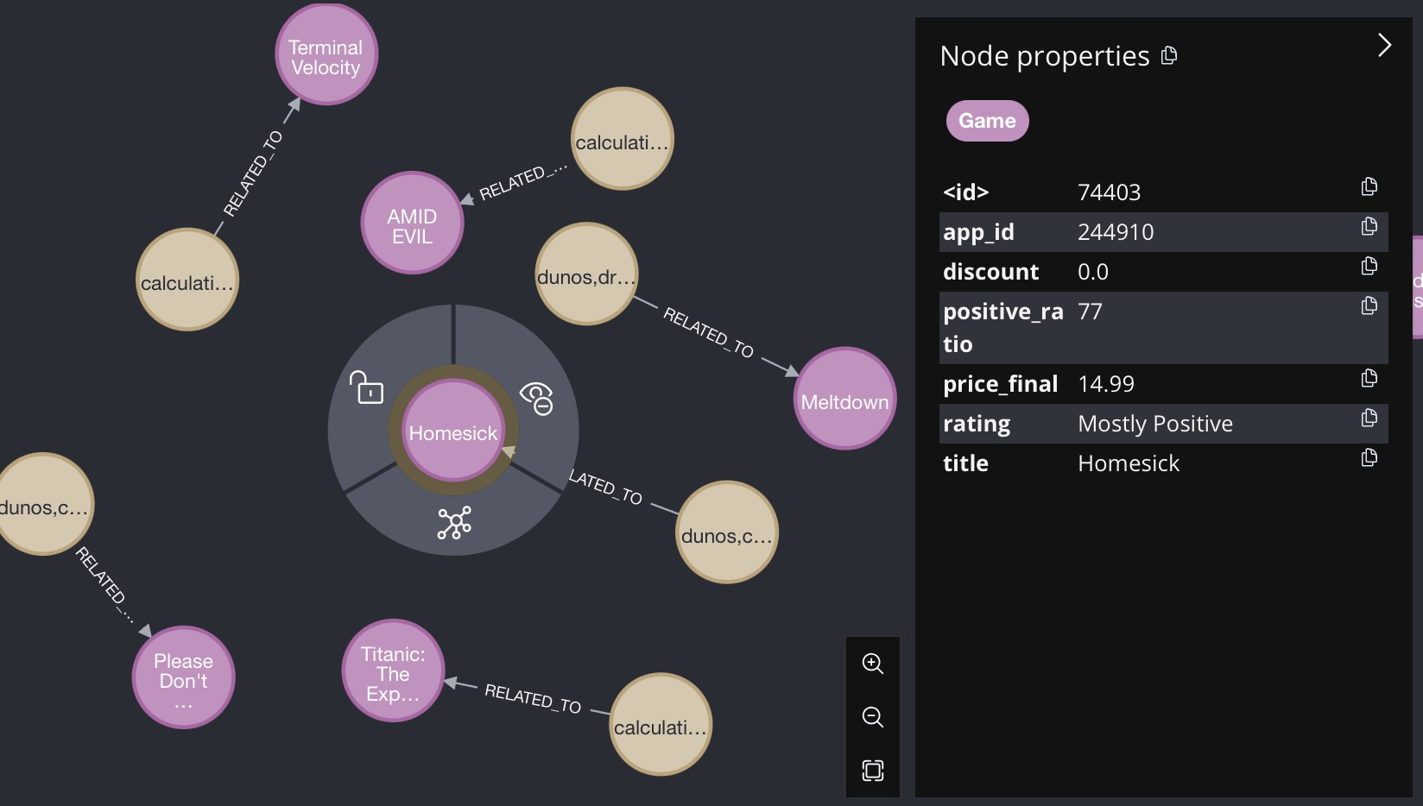
Topic Modeling
Visualizing topics and games with Neo4j
Neo4j Data: import the topic data to neo4j and create a Node called Topic.
Connection: Displayed games and topic nodes, create relationship ‘related to’.

Slide 21
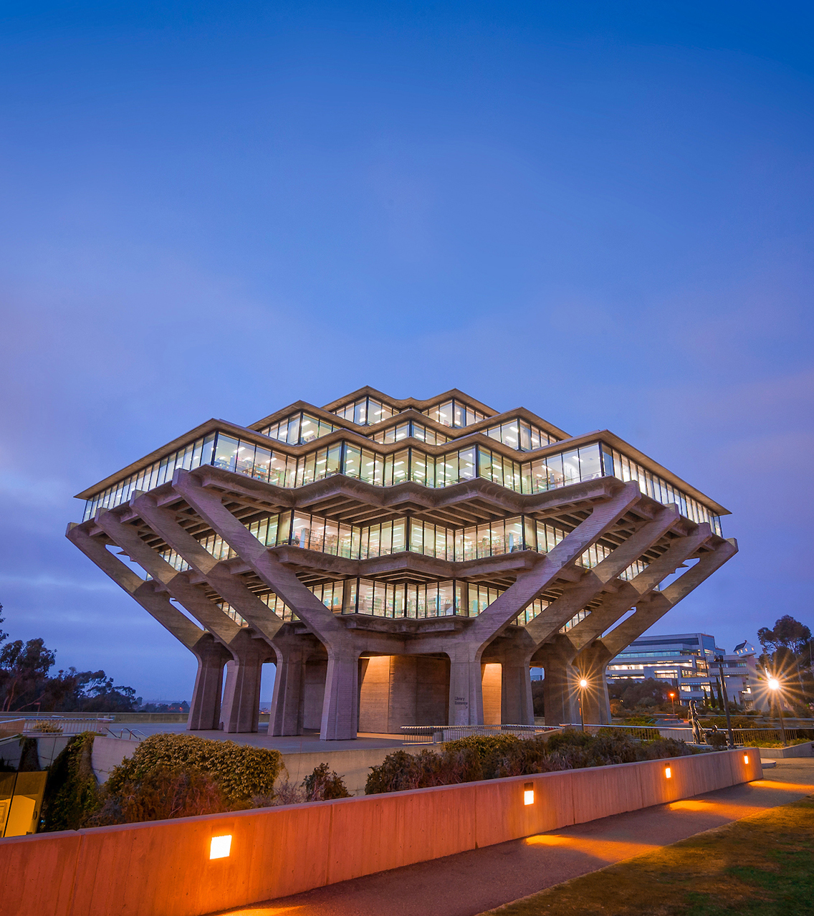

Thank you!
Xueqi Wang,
Jiacheng Qiu,
Sihan Wang.
11/12/2023
Blue Notch Template

